Slide 1
The Future of Cycling in Seattle:
A Data Science Approach to Ridership Forecasting Robert Barrentine, Arthur Setiawan, Yen-Ting Chen, Justus Ngunjiri DATA 5100 | Foundations of Data Science | FQ22
Notes:
(Arthur)

Slide 2
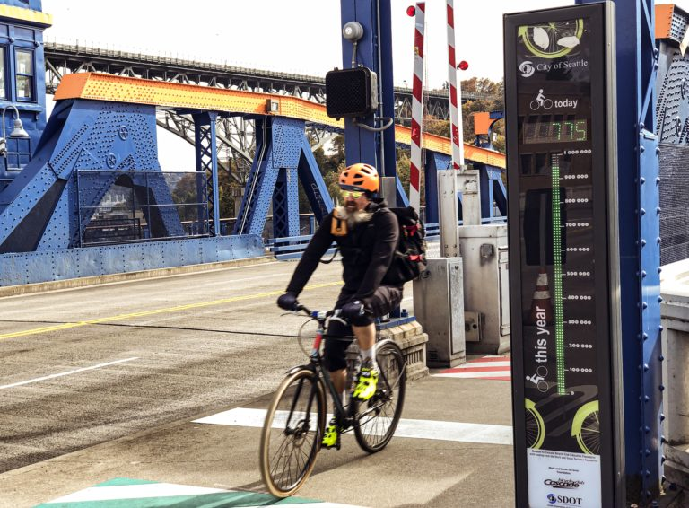
Agenda
Background
Goal of the Project
Exploratory Data Analysis
Forecasting Methodologies
Findings and Take-aways
Potential Future Projects
Notes:
(Arthur)

Slide 3



Cycling in Seattle
Way of Life
and
Community Building
Discover Seattle
and
Improve Health
Eco-Friendly Future
and
Save on Gas
https://www.seattletimes.com/life/outdoors/seattles-not-just-the-countrys-most-bike-friendly-city-its-a-biking-community-here-are-the-reasons-we-ride/
Notes:
(Arthur)
https://www.google.com/url?sa=i&url=https%3A%2F%2Fwww.seattletimes.com%2Flife%2Foutdoors%2Fseattles-not-just-the-countrys-most-bike-friendly-city-its-a-biking-community-here-are-the-reasons-we-ride%2F&psig=AOvVaw1hXzBPBVYtNzRCUcBaBStb&ust=1670208996523000&source=images&cd=vfe&ved=0CBAQjhxqFwoTCLDIj8H73vsCFQAAAAAdAAAAABAE

Slide 4
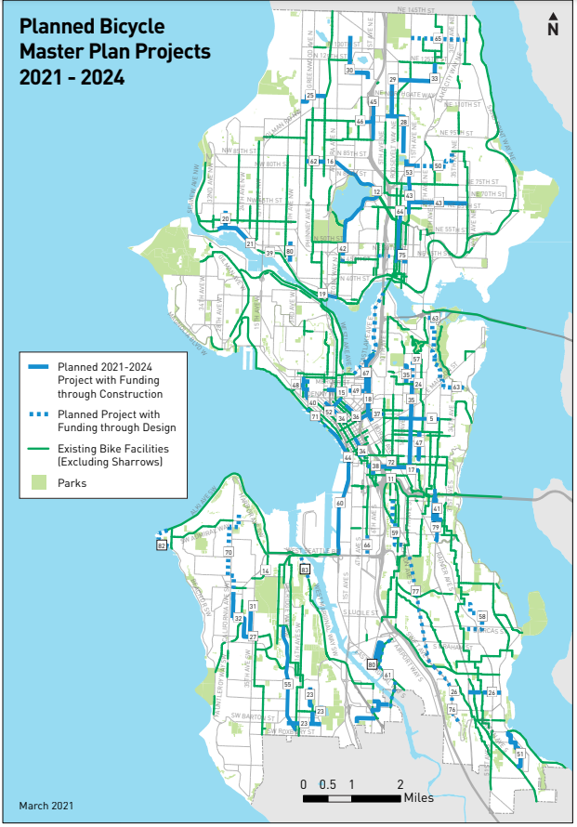
Some Statistics!
Seattle is a Cycling City!
No. 6 in U.S. of cycling commuters per capita
Seattle Bicycle Master Plan (BMP):
9-year $1B Levy to Move Seattle (30% of transportation budget)
Current BMP progress 2016 - 2020:
45+ miles added to network
1,500+ bike parking spots added
1.2M cyclists counted on Fremont Bridge in 2019
https://www.seattle.gov/transportation/document-library/citywide-plans/modal-plans/bicycle-master-plan
https://www.google.com/url?q=https://www.move.org/cities-most-bicycle-commuters
Notes:
(Arthur)
https://www.move.org/cities-most-bicycle-commuters/ 2019 data
https://www.seattle.gov/Documents/Departments/SDOT/BikeProgram/BMP_Imp_Plan_2021_FINAL.pdf Seattle Bicycle Master Plan (BMP)

Slide 5
Goal of the Project
Exploratory Data Analysis
The EDA is to use graphing techniques to create a descriptive overview on the entirety of the phenom presented in the data problem
Forecasting methodology
The two paradigms we are using in our forecasting methodologies are Statsmodels STL and Facebook Prophet
Notes:
(Yen-Ting)
The graphs used in EDA has to match a certain standard that can be clearly understood and without too in depth discussion
Models such as decompositions and other more sophisticated models are discussed without assumptions of dataset.
The forecasting methods can be flexible or inflexible; however, in our case, mostly are inflexible which is high bias and low variance.
Forecasting is measured against by best metric.
Common metric for measuring forecasting methodologies are accuracy, correlation, rmse, and mae.

Slide 6
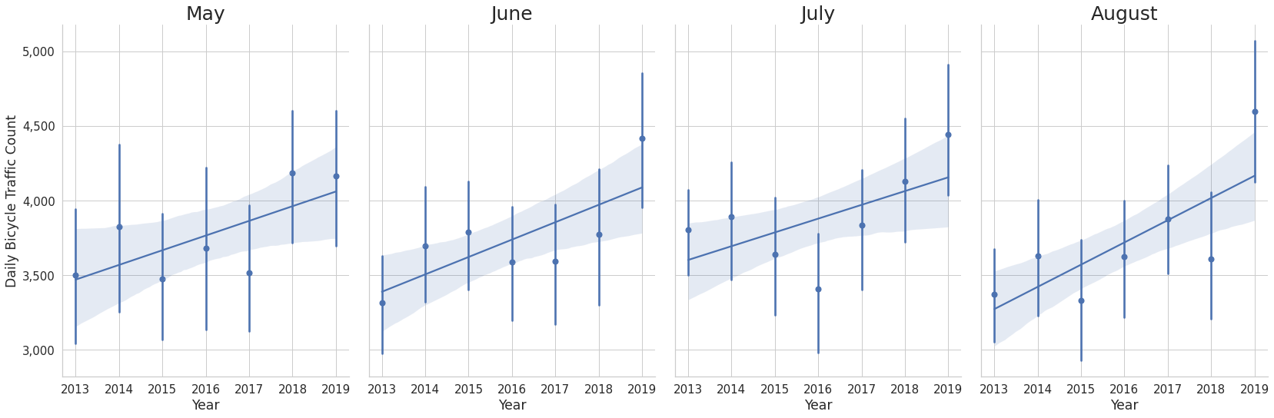
Exploratory Data Analysis
Highest ridership months throughout Summer months (May - August)
Ridership increasing consistently year-by-year
2019 peak ridership recorded recorded at 1.2M, dropped to 772K in 2020
Peak traffic Monday to Friday, more or less double weekend traffic
Pre-Pandemic Daily Ridership for Summer Months
Notes:
(Yen-Ting)
Obvious that ridership must have dropped from 2019 to 2020 2021. Here we can’t see clear seasonality in the year-by-year graphs, but we can see yearly patterns in the next few slides.
State that we found out most ridership months of the year are May - Aug (Summer). We can see that throughout the months, ridership has increases year by year.
The variance between each month fluctuates along with the progression of the years. So here we can see the interval widths correlating between the yearly progression of different months.

Slide 7
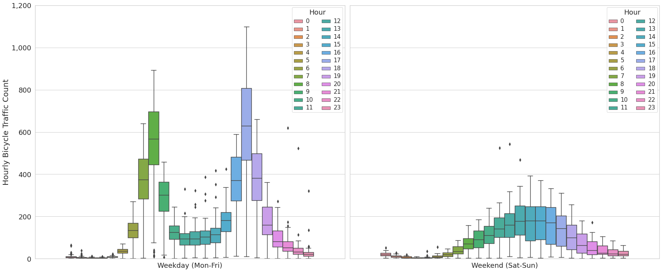
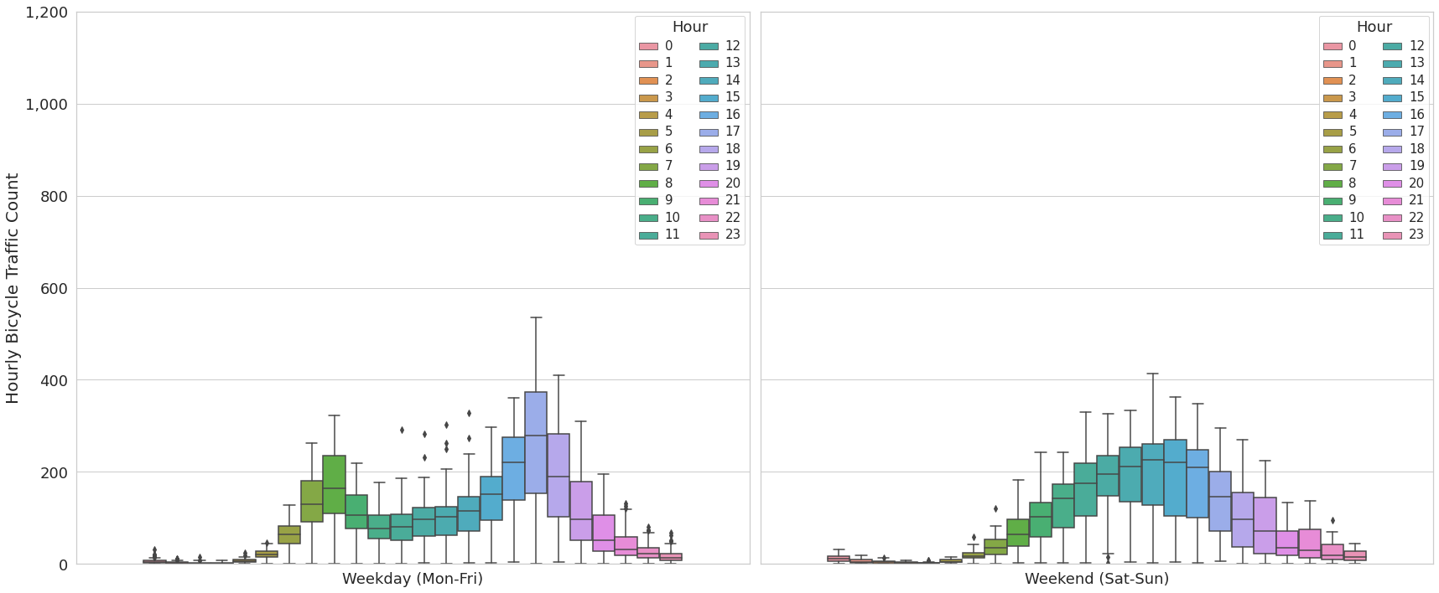
Exploratory Data Analysis
Both bimodal distributions, traffic peaks at 9 A.M. and 6 P.M.
Median ridership at peak hours drops from approximately 600 in 2019 to 300 in 2021
Midday traffic remains consistent in both 2019 and 2021
Median hourly traffic higher in 2021 weekends than 2019 weekends, indicative of leisure
2019 Hourly Ridership
2021 Hourly Ridership
Notes:
(Yen-Ting)
Obvious that ridership must have dropped from 2019 to 2020 2021, instead focus on seasonality
State that we found out most ridership months of the year are May - Aug (Summer)

Slide 8
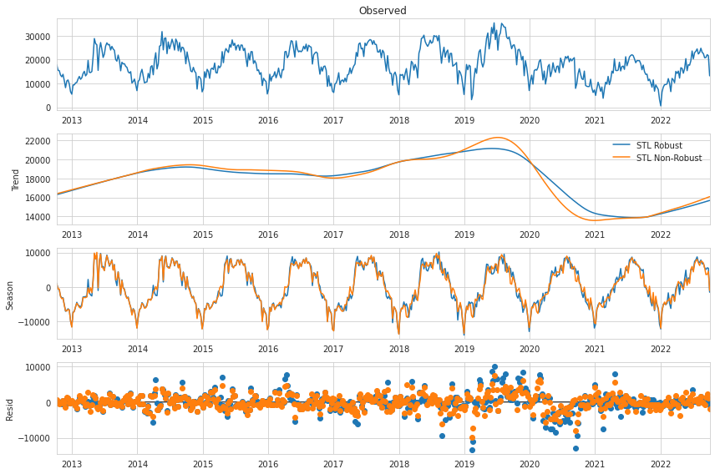
STL: Non-Robust vs Robust
STL:
Season-Trend decomposition using LOESS
LOESS:
LOcally Estimated Scatterplot Smoothing
Robust (Y/N):
Enables data-dependent weighting function to reduce errors in model
Pro: Locally-weighted model is flexible
Con: Computationally intensive
Notes:
(Robert)

Slide 9
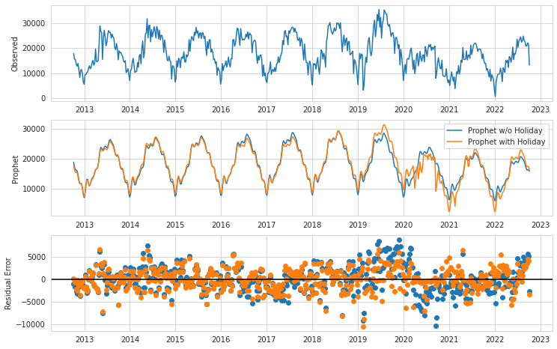
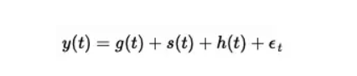
Facebook Prophet: COVID-19 Data Conditioning
Presence of trends at all /changepoints
Linear, logistic or flat
Seasonality and holiday
Fourier order 3
Error term
Obvious improved residual error difference
Covid conditioning and lockdowns
Pro: handles multiple seasonalities well
Con: under detection of causal relationships
Notes:
(Justus)

Slide 10
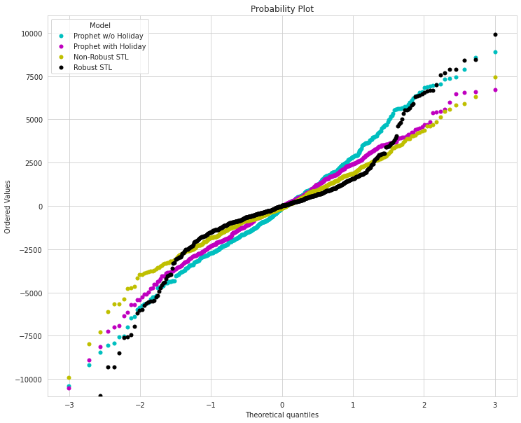
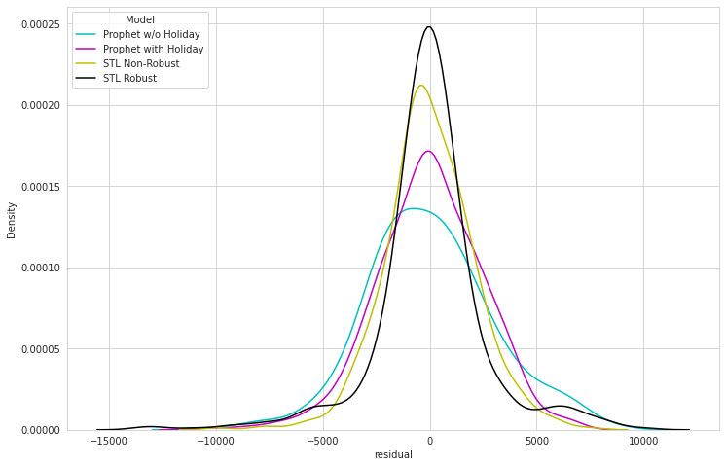
Compare Residuals
to Determine Best Fit
Notes:
(Robert)

Slide 11
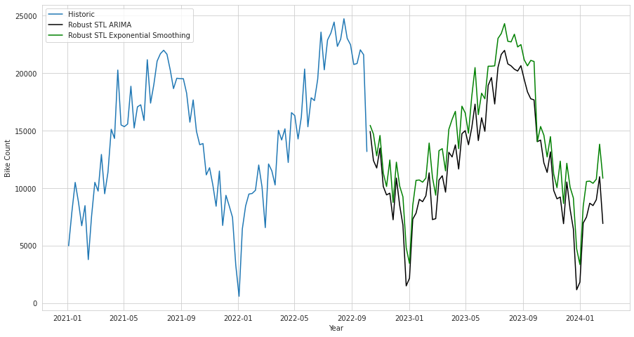
STLForecast:
ARIMA vs Exponential Smoothing
ARIMA:
Auto-Regressive Integrated Moving Average
combines autoregressive and moving average models as well as a differencing, pre-processing step
Exponential Smoothing:
a smoothing constant is applied and varied to reduce errors to a minimum between present and forecasted values
Notes:
(Robert)

Slide 12
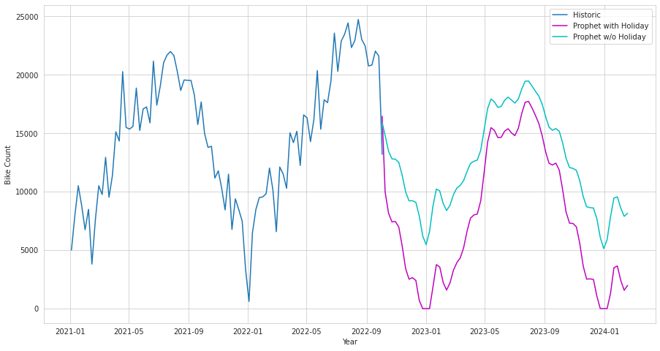
Facebook Prophet:
Holiday Conditioning - COVID-19
Lower count with
holiday condition
Consistent with
residual error plots
Negative predictions
with Holiday model
Defies expectations
Min max predicted peaks
Consistent trends and under detection of causal relationships
Notes:
(Justus)

Slide 13
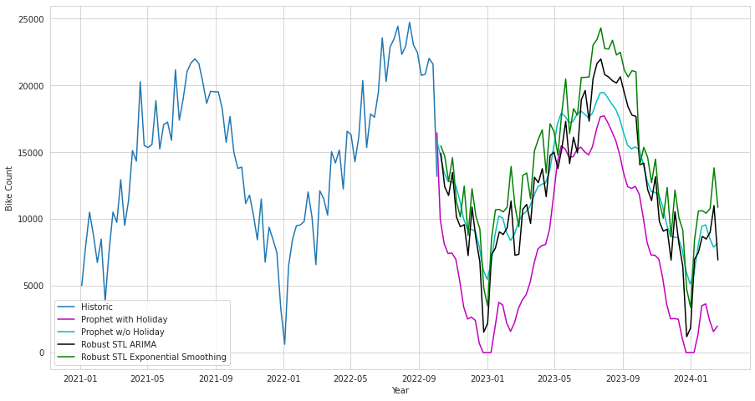
STLForecast vs. FBProphet
Prediction performance consistent with
residual errors plot
STL models performed best
Predicted trends are consistent
Notes:
(Justus)

Slide 14
Key Take-Aways
& Future Developments
Dataset:
Highly complex seasonality observed in bicycle traffic dataset !
Modeling:
Fine-tuning of model parameters may improve model performance
Prophet able to accommodate COVID lock-down time frames
Next Steps:
Apply same methodology on other Seattle bike counter datasets
Correlate other time series dataset to identify correlation / causation
Further investigate TensorFlow, familiarize with CNN, RNN, LSTM, GRU
Notes:
(Justus)

Slide 15

Thank You!
Any questions?
Notes:
(Justus)

